Slide 1
End Project Presentation
Alex Manuskin and Gil Zuker Under the supervision of Oz Shmueli

Slide 2
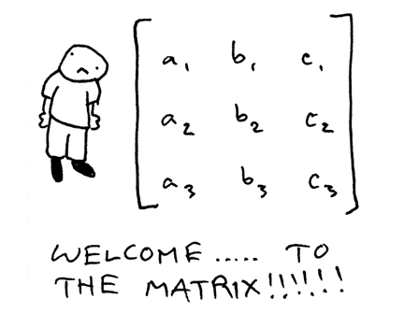
Project goal
Creating a user friendly MATLAB function to manage matrix multiplication across available resources on the device, including GPUs CPU and FPGAs

Slide 3
Tools
MATLAB
NVIDIA GPUs and GPGPU API: CUDA
Visual Studio for profiling using Nsight

Slide 4
What was achieved
Created a MATLAB function that currently performs multiplications on multiple GPUs and CPU.
Using existing BLAS libraries to perform CPU and GPU calculations.
Created a platform for FPGA integration.
Added capability to balance the workload between CPU/FPGAs/GPUs
Created environment for function integration

Slide 5
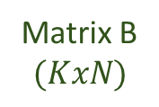
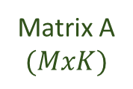
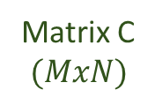
Method
Step 1: Distribute workload between GPUs and CPU/FPGAs
CPU+FPGA
The matrixes are divided by cublasXt logic
Load distribution is passed as a parameter and should be optimized per system
Matrix A $$(MxK)$$
Matrix B $$(KxN)$$
Matrix C $$(MxN)$$
GPUs
CPU+FPGA
FINAL RESULT
GPUs
CPU+FPGA
GPUs

Slide 6
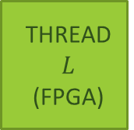

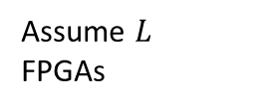
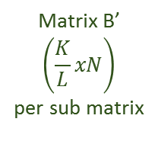


Method: CPU FPGA
Step 2: Distribute workload between CPU and FPGAs
Distribution between threads could be different
Matrix B’ $$\left(\frac{K}{L}xN\right)$$
per sub matrix
Matrix C’ $$\left(Mx\frac{N}{L}\right)$$
per sub matrix
Matrix A’ $$\left(MxK\right)$$
THREAD 0 (CPU)
THREAD 1 (FPGA)
THREAD $$L$$ (FPGA)
THREAD 0 RESULT
THREAD 1
RESULT
THREAD $L$
RESULT
Matrix A
Assume $L$ FPGAs

Slide 7
Performance
2x speedup over CPU performance
1.5x speedup over GPU only performance
Best performance achieved at 40% CPU, 60% GPU
Consider low performance GPU were used
Matrix size exceeds available memory on GPU!
Better speedup with larger matrixes

Slide 8
Nsight Analysis
Proof of parallelism in computations

Slide 9
Testing
Performance depends on hardware and matrix size
A test bench was created to find the optimal workload per setting. (A fast and slow variant).
Although the graphs may seem linear, testing showed high error rates when applying crude linear equations to finding the optimal operation point

Slide 10
FPGA integration
To simulate FPGA operation, the current solution is performing the multiplication on separate threads on the CPU
The option of integrating an FPGA was tested by compiling the driver and function provided by Noam Eliyahu into our code
FPGA driver function, preferably with the following characteristics:
Col major input
Possible to copy memory with permanent intervals e.g. A10X15
A[1..3][1], A[1…3][2], A[1…3][3]
Address(A[1][1]-A[1][2]) = lda=10
Etc…
Signature of BLAS functions for example: gemm(M, N, K, matrix_A, lda, matrix_B, ldb, matrix_C, ldc);

Slide 11
Matrices Structure In memory
A matrix's memory space is defined by four parameters:
Row Major / Column Major
M – The row number
N – The column Number
LDA – the leading dimension of the matrix
M and N are simple to understand.
LDA is created when the matrix is initialized, M for Column Major, N for row major.
LDA is important when wanting to perform action with parts of a larger matrix.
Matrix A(4x5)
LDA
0 | 4 | 8 | 12 | 16
1 | 5 | 9 | 13 | 17
2 | 6 | 10 | 14 | 18
3 | 7 | 11 | 15 | 19
M
N

Slide 12
Limitations
Only the infrastructure for the FPGA exists
Matrixes limited to memory size
Need Cublas-XT License to use more than 2 GPUs (free from NVIDIA)

Slide 13
Conclusions
The project goals were achieved, we have successfully created a simple to use MATLAB function which invokes all the system resources.
Our project, as well as many others, show that heterogeneous systems are the future.
Our project to harness this power via a friendly MATALB function.

